Slide 1

Chapter 13: Code Generation
陳奇業 成功大學資訊工程系

Slide 2
Generating Instructions from Three-address Code
Example: D = (A*B)+C
0 1 2
=* A B T1
=+ T1 C T2
= T2 D

Slide 3
Skeletons
=+ => Load R1 0 (first parameter)
Add R1 1 (2nd parameter)
Stor R1 2 (3rd parameter)
=* => Load R1 0 (first parameter)
Mul R1 1 (2nd parameter)
Stor R1 2 (3rd parameter)
= => Load R1 0 (first parameter)
Stor R1 2 (3rd parameter)

Slide 4
Thus we get:
Load R1 A
Mul R1 B
Stor R1 T1
Load R1 T1
Add R1 C
Stor R1 T2
Load R1 T2
Stor R1 D
There are 8 instructions.

Slide 5
Additional skeleton (pseudo-operators)
FX : fetch if not already available (有需要才fetch)
Code generator must remember what is in each register.
Thus we have
=+ => FX R1 0 (first parameter) =* => FX R1 0
Add R1 1 (2nd parameter) Mul R1 1
Stor R1 2 (3rd parameter) Stor R1 2
= => FX R1 0
Stor R1 2

Slide 6
Thus we get
Load R1 A
Mul R1 B
Stor R1 T1
Add R1 C
Stor R1 T2
Stor R1 D
There are 6 instructions
Load R1 A
Mul R1 B
Stor R1 T1
Load R1 T1
Add R1 C
Stor R1 T2
Load R1 T2
Stor R1 D

Slide 7
Another Pseudo Operator SX
SX - store if not used right away (or if it is not a temporary variable (e.g., T1, T2, etc.)) (如果沒有馬上使用才store)
Thus we have:
=+ => FX R1 0 (first parameter) =* => FX R1 0
Add R1 1 (2nd parameter) Mul R1 1
SX R1 2 (3rd parameter) SX R1 2
= => FX R1 0
SX R1 2

Slide 8
Thus we finally get:
Load R1 A
Mul R1 B
Add R1 C
Stor R1 D
There are 4 instructions.
Load R1 A
Mul R1 B
Stor R1 T1
Add R1 C
Stor R1 T2
Stor R1 D

Slide 9
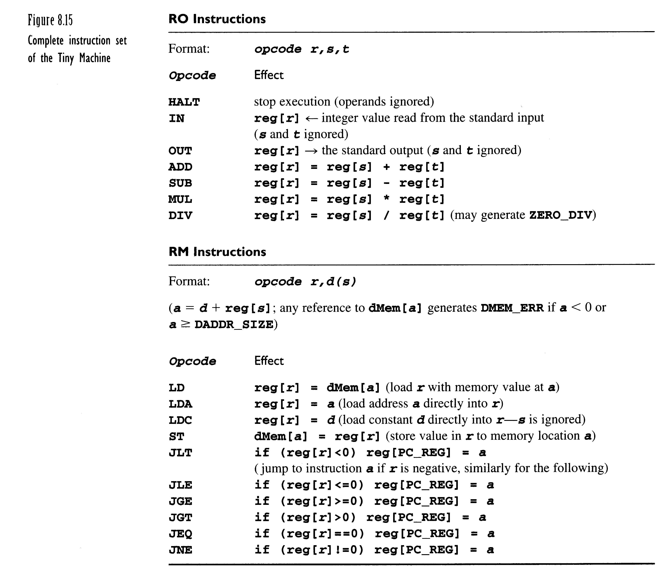

Slide 10
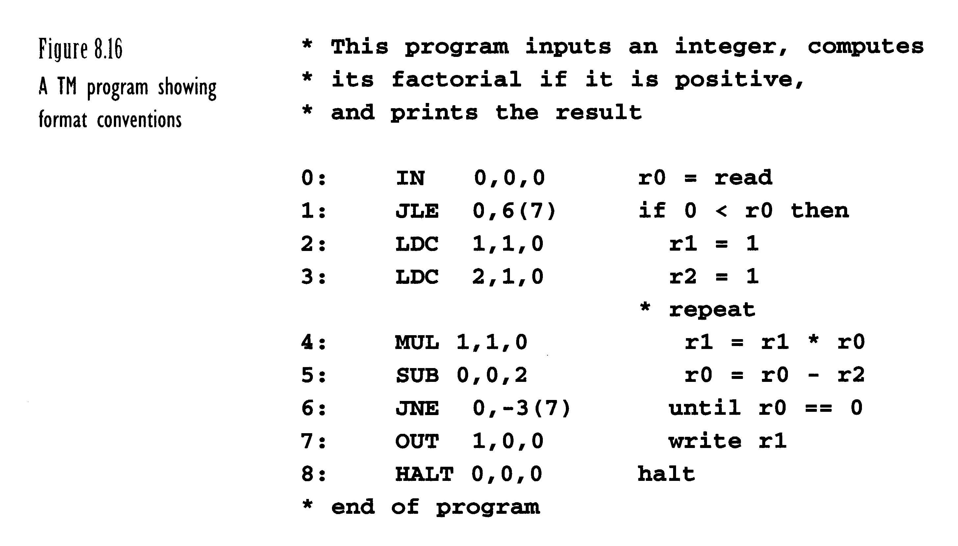
r7=1
r7=6

